Slide 1

Using python for machine learning with large gridded datasets
Noah Brenowitz
November 5, 2018
Python in the Geosciences Seminar
Notes:
Videos available here: https://cimss.ssec.wisc.edu/data/

Slide 2
Hello from the clouds!
Atmospheric science is a geoscience too, but we have different needs and datasets than much of the GIS/remote sensing community
Larger scales (10s to 10000s of kms)
Often working with simulation output
Mostly interested in 3D rather than 2D fields
We like clouds

Slide 3
But there are some similarities
We go to AGU too
It’s the same planet
Very large spatio-temporal datasets

Slide 4
Machine learning parametrization
My research project

Slide 5
What is a weather model?
If it is true, as any scientist believes, that subsequent states of the atmosphere develop from preceding ones according to physical laws, one will agree that the necessary and sufficient conditions for a rational solution of the problem of meteorological prediction are the following:
1. One has to know with sufficient accuracy the state of the atmosphere at a given time.
2. One has to know with sufficient accuracy the laws according to which one state of the atmosphere develops from another.
- Bjerknes (1904)
Vilhelm Bjerknes
Notes:
But what is a weather/climate model?
The father of meteorology Vilhem Bjerknes said this quote...which I will read
<read slide>
In this talk I will focus on number 2 <click>
Traditionally, data has had it’s strongest impact on point 1, but in this work we focus on using data in part 2.

Slide 6
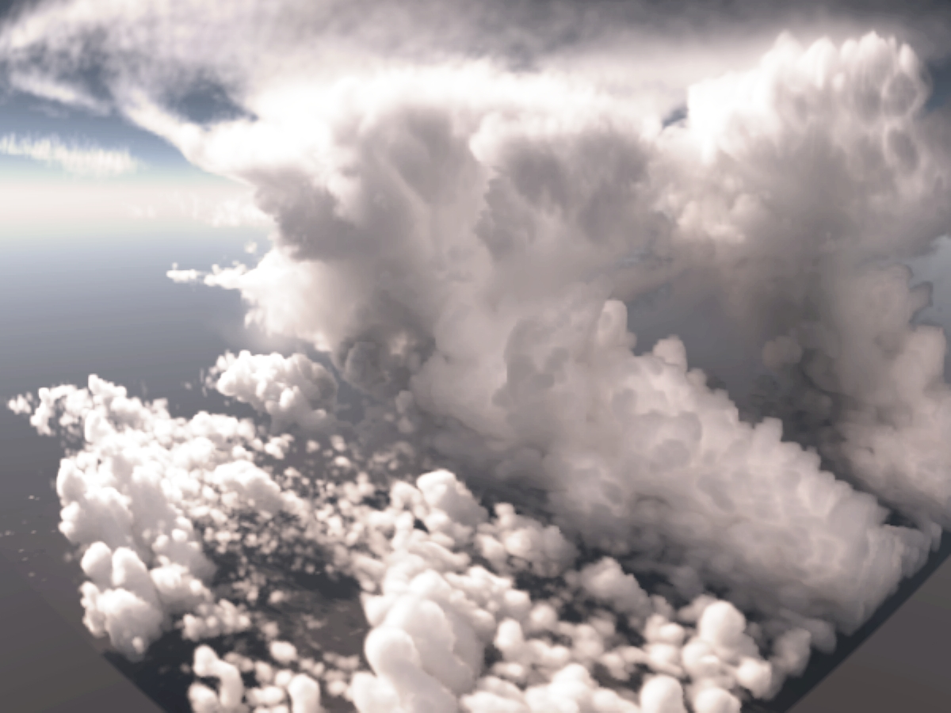
High resolution models produce realistic clouds
Giga-LES (Khairoutdinov et al. 2009)
100x100 km with 100 m grid
Notes:
Now, on certain scales, we know the physical laws describing atmospheric motions well enough to create extremely realistic depictions of clouds and other small-scale atmospheric phenenomena.
This is a visualization from a large-eddy-simulation performed using the SAM model on a 100m grid.

Slide 7
Can only solve at coarse resolution
Image from NOAA
Notes:
Now, this simulations uses a similar number of degrees of freedom for one 100 km squared box as a climate model does for the whole planet.
So it’s just not practical to perform simulations at that level of accuracy.

Slide 8
Coarse resolution equations
Apparent heating (K/day)
SW+ LW radiation, latent heating, etc
Apparent moistening (g/kg/day)
Notes:
Instead of solving the fine resolution equations we end up solving the coarse-resolution equivalent. Here, I am showing the coarse resolution budgets of dry static energy, water vapor mixing ratio, and momentum. These budgets are forced by some terms which are known on the coarse-grid scale, such as advection, and the coriolis force.
Bar denotes the average over a GCM grid box. The grad bar is a coarse grained approximation of the gradient.
The right hand side denotes the residual terms, which are known as the apparent heating (Q1), which includes raditiona nad latent heating, and the apparent moistening (Q2), which describes phase changes of water. Likewise there is a residual term in the momentum budget (Q3) related to turbulent mixing.
The taks of parametriztion is to close these budgets, and write Q1-Q3 as a functions of the coarse-resolution variables alone.
&\frac{\partial \overline{s}} {\partial t} + \mathbf{\overline{v}} \cdot \overline{\nabla} \overline{s} = Q_1 \\
&\frac{\partial \overline{q}} {\partial t} + \mathbf{\overline{v}} \cdot \overline{\nabla} \overline{q} = Q_2\\
&\frac{\partial \overline{\mathbf u}} {\partial t} + \mathbf{\overline{v}} \cdot \overline{\nabla} \overline{\mathbf u} + \mathbf{f}\times \overline{\mathbf{u}} -\frac{1}{\rho} \nabla \overline{p} = Q_3\\

Slide 9
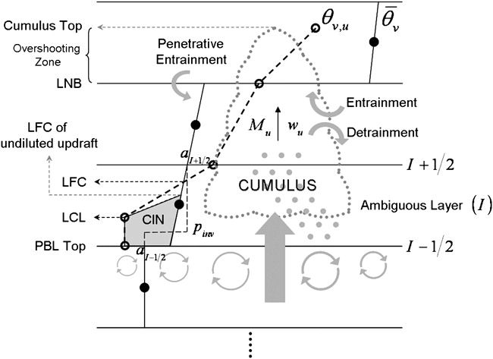
How we usually build parametrizations
High resolution simulation or observations
Notes:
So how do we normally go about this.
A scientist will interpret a complex set of simulations or observatiosn and reduce them to a simplified flow chart. This flow chart will then be turned into a Fortran code, and if it’s succesful be intergrated into a climate model.
While this approach has yielded great benefits, it is evident that it can improved. For example, the pace of development in parametrization is very slow. In particular, deep convective parameterizations have not changed much in the past two decades even though many new high resolution models and observations have become available. I will argue that the main bottleneck process is this person…the scientist.

Slide 10
Parametrization is a function approximation problem
Machine Learning
Q1
Q, T, U, V, …
Q2
Q3
Notes:
So how do we move past this situation?
Essentially, param is a function approximation problem. It takes in the profiles of humiidity, temperature, etc and produces the apparent source terms Q1, Q2, and Q3.
By using simplified physical models, we essentially limit the class of functions that we can use to just those which are interpretable by humans at the cost of accuracy. Here, I will argue that treating parametrizations as a black box machine learning problem can help us move past this bottleneck. While many may not like black boxes, the fact is many or most physically based parametrizations already are black boxes to most climate modelers. This is even more true when considering the fully coupled interactions of many different parametrizations.

Slide 11
Machine learning models

Slide 12
Machine learning builds black boxes
Easy to tune/train
Easy to interpret
Many parameters
Few parameters
Many 1000s of parameters
Need a lot of data
Designed to be trained not interpreted
Examples: Decision trees, neural networks, support vector machines
Notes:
The defining attribute of machine learning is the complexity of the models it uses.
To illustrate this point, I would like to use this complexity spectrum. On the right are models, like most current parametrizations, that are easy to interpret because they have few parameters. On the other side, are models that have many thousands of parameters, which are easier to train. This might seam paradoxical, but in a higher dimensional parameter space there might be many more ”right answers” than in a low-dimensional space.
Some examples include…<read slides>

Slide 13
Neural Networks
Activation function
Notes:
Now, I have always found that description a little confusing, so here are the equations. The values at each layer are just a linear transform of the previous layer followed by applying a nonlinear function. This nonlinear function is known as an activation function.
So the parameters of a neural net are the weight matrices A_1,… and the constant vectors b_1…

Slide 14
Decision Trees
No
Stable temperature profile?
Yes
Moist boundary layer?
Yes
No rain
no
No rain
Notes:
One classic machine model is a decision tree, such as the one pictured here.
Read the decision tree.

Slide 15
…but can be hard to interpret
Very similar to a lookup table…non-continuous outputs
Notes:
But they can be hard to interpret for many input variables.
Also, they do not have continuous outputs, which seems a poor match for physics problems like convective parameterization.

Slide 16
Training Data
Notes:
I’ve talked about the models a little a bit, so let’s talk about the training datasets. And this section will serve as an introduction to some past work on machine learning parametrization.

Slide 17
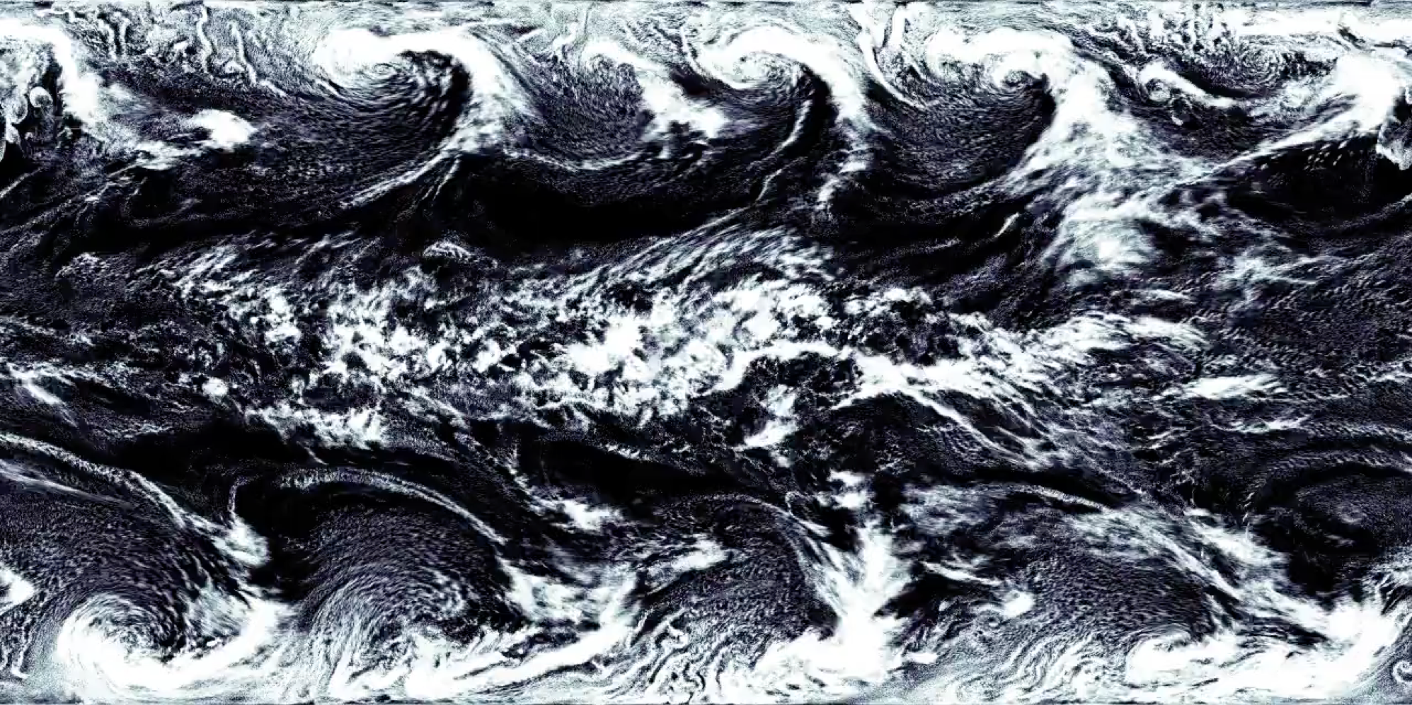
Near-global aqua-planet (NG-Aqua) simulation generated by the System for Atmospheric Modeling ($Δx=4$km)
Notes:
Our training dataset is a simplified GCRM simulation performed using the System for Atmospheric modeling (by Marat Khairtoudinov). We call it the near-global aquaplanet simulation or NGAqua
Mention the aspects of the simulation
Diurnal cycle
mid latitude cyclones
Tropics (w/ eastward disturbance)
Now, this dataset was not designed for machine learning, so they did not store moisture or temperature budget information. And the sampling interval is relatively coarse in time.

Slide 18
Coarse-grain data to 160 km boxes
Notes:
For this study, we focused on the tropics, where moist atmospheric convection plays an especially important role.
We coarse grain the 4 km NGAqua data onto a 160km grid, representative of a typical climate model resolution. This resolution was partially chosen so that the precipitation de-correlates over a time scale of about 3-6 hours.

Slide 19
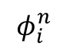
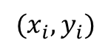
Machine learning inputs
$$φ_{i}^{n}$$
Preprocessing:
concatenate
center/scale
$$(x_{i},y_{i})$$
Notes:
Within each grid box we have measurements at different heights of humidity and dry static energy.
There are 34 vertical grid points for each variable, which we concatenate into a single 68 dimensional vector.
The data are normalized by subtracting the mean and dividing by a mass-weighted variance.

Slide 20
What are some things that make ML with “geoscience” datasets hard?
Heterogeneous (many other fields have this problem)
Soooo much data (TB datasets are incredibly common)
3D or 4D data
The earth is not flat

Slide 21
Python tools I use:
HoloViews

